Slide 1

Telemarketing Effectiveness for Banking Institutions
Haryo Prabowo

Slide 2

Outline
BACKGROUND
DATA FEATURES AND ANALYSIS
MACHINE LEARNING MODEL AND INTERPRETATION
CONCLUSION

Slide 3
Background

Slide 4
THE DATA IS RELATED TO TELEMARKETING CAMPAIGNS (PHONE CALLS) OF A PORTUGUESE BANKING INSTITUTION.
Telemarketing require huge investment as large call centers are hired to execute these campaigns
The marketing campaigns were based on phone calls to sell term deposits
The datasets contain data about bank clients that has been subscribed ('yes') or not ('no’) to the bank’s term deposit because of the telemarketing.

Slide 5



THE ORIGINAL DATASETS CONTAINS 3 MAIN TYPES OF FEATURES
Age
Job
Marital
Education
Balance
Housing
Loan
Contact
Day
Month
Duration
Campaign
Pdays
Previous
Poutcome
Client Personal Data
Last Contact of the Telemarketer
Other Attributes
Notes:
bank client data:
age (numeric)
job : type of job
marital : marital status (categorical: "married","divorced","single"; note: "divorced" means divorced or widowed)
education (categorical: "unknown","secondary","primary","tertiary")
default: has credit in default? (binary: "yes","no")
balance: average yearly balance, in euros (numeric)
housing: has housing loan? (binary: "yes","no")
loan: has personal loan? (binary: "yes","no")
related with the last contact of the current campaign:
contact: contact communication type (categorical: "unknown","telephone","cellular")
day: last contact day of the month (numeric)
month: last contact month of year (categorical: "jan", "feb", "mar", …, "nov", "dec")
duration: last contact duration, in seconds (numeric)
other attributes:
campaign: number of contacts performed during this campaign and for this client (numeric, includes last contact)
pdays: number of days that passed by after the client was last contacted from a previous campaign (numeric, -1 means client was not previously contacted)
previous: number of contacts performed before this campaign and for this client (numeric)
poutcome: outcome of the previous marketing campaign (categorical: "unknown","other","failure","success")
Output variable (desired target):
y - has the client subscribed a term deposit? (binary: "yes","no")

Slide 6
Questions
Which type of customers that will subscribe to the bank’ term deposit because of the telemarketing?
What are the factors for a telemarketing campaign to be successful?
How do we predict whether a client will subscribe to a term deposit by telemarketing?

Slide 7
Data Features and Analysis

Slide 8
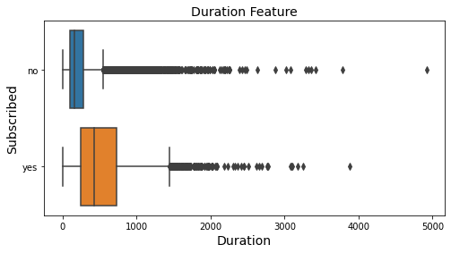
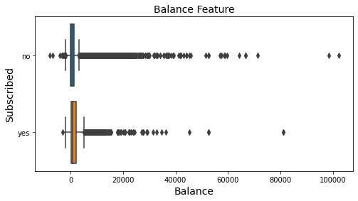
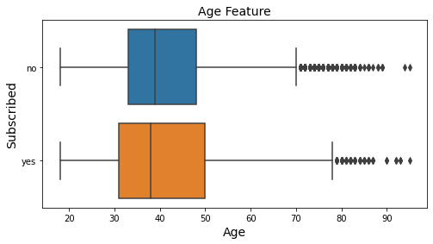
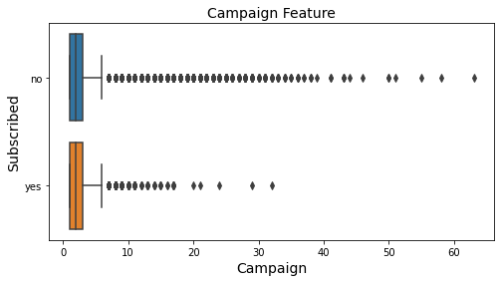
Most of the people reject the subscription offer in the first 2 minutes. The mostly targeted and accepting clients are aged between 30-50 years old. Other numerical features aren’t too useful
Notes:
Duration: We can see that when duration is between 0 and the 2 first minutes most of the people reject the offer. The remanent samples take a decision in a range greater than 2 min up to 12 min. Just a very few take quite a long to both reject or accept the offer.
Balance: With 0 as median, it means that majority of the people contacted have zero yearly balance
Age: The most targeted and potentially the most accepting of telemarketing are clients aged between 30 to 50 years old
Campaign: The outcome of contact frequency between clients who are subscribed and not are almost 50:50. Contacting client too frequently are counter-productive

Slide 9
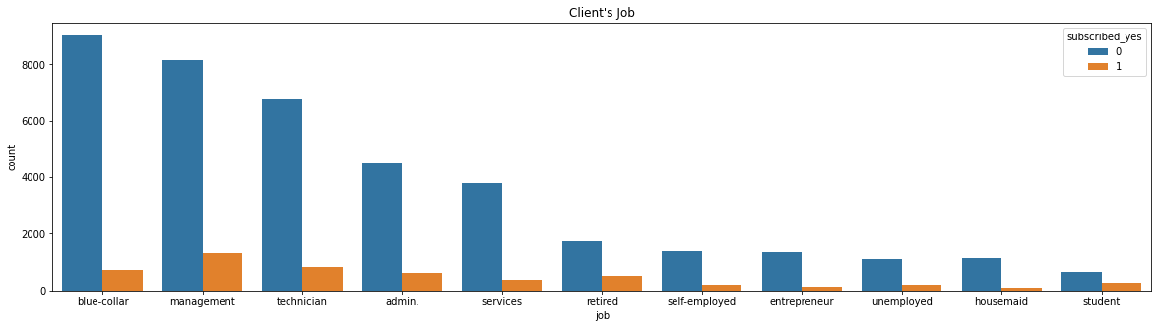
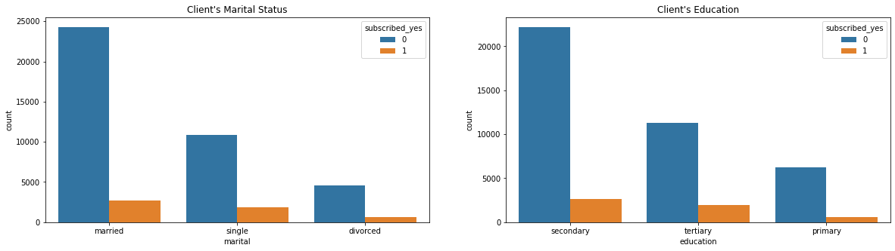
Most clients have professional jobs. Proportional to the sample, more married people and more educated people means more subscribers
Notes:
Most clients that are contacted and subscribed to term deposits have professional jobs and higher qualification relative to others
The bank contacted more married people than single and divorced. Proportional to the sample, more married people means more subscribers
More people with higher education degrees were subscribed. Proportional to the sample, more educated people means more subscribers

Slide 10
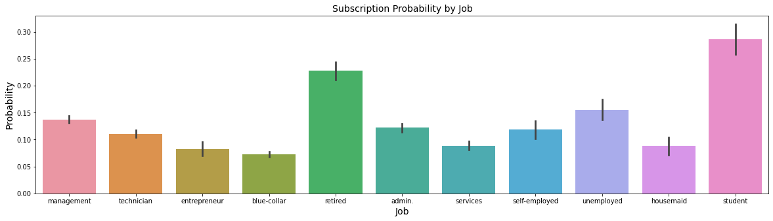
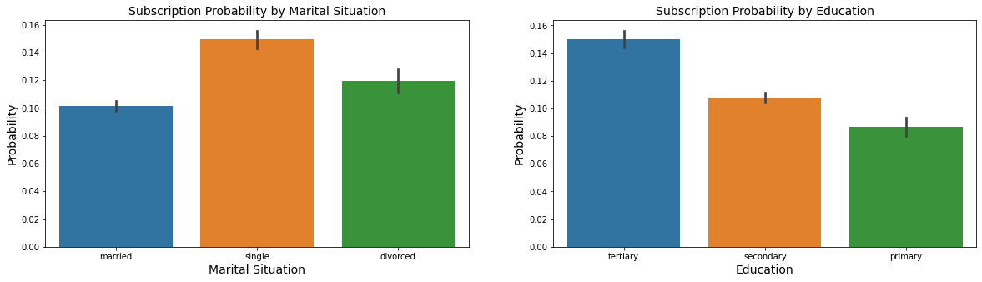
Groups of students and retired people, single, and people with higher education tend to subscribe the term deposit because of the telemarketing
Notes:
*when adjusted for the imbalance

Slide 11
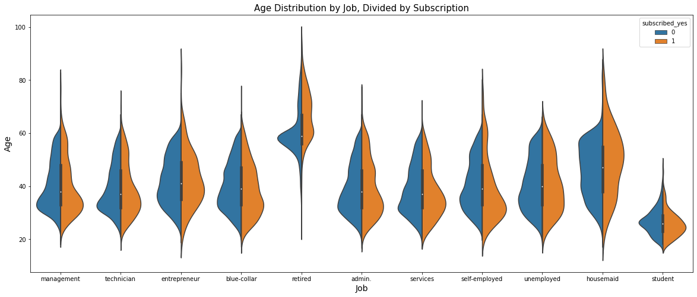
Older people tend to be more susceptible and accepting to telemarketing
Notes:
Especially housemaids

Slide 12
Machine Learning Model and Interpretation

Slide 13
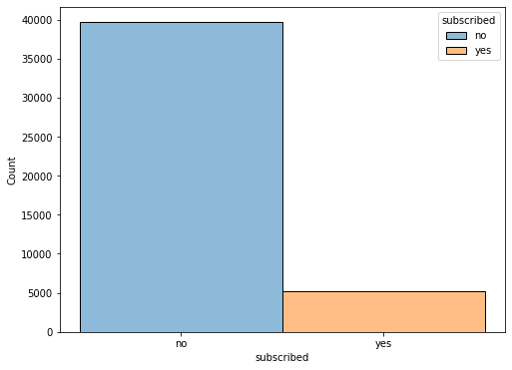
The model is created with 80:20 train-test split, with SMOTE algorithm applied to address the imbalanced data
Using F1 Score as the main metric, LGBM and GradientBoosting Classifier will be chosen as the models for further processing
Trained Models
Term Deposit Subscribers by Telemarketing
Models | Accuracy | F1 Score
LGBMClassifier | 0.9182050151209677 | 0.49413808076422056
GradientBoostingClassifier | 0.8716922883064516 | 0.4938941655359566
AdaBoostClassifier | 0.8463016633064516 | 0.48271231957032557
RandomForestClassifier | 0.9999842489919355 | 0.47257383966244726
SGDClassifier | 0.7741462953629032 | 0.45668353676689494
KNeighborsClassifier | 0.9189610635080645 | 0.4236453201970443
BaggingClassifier | 0.994597404233871 | 0.41681901279707495
GaussianNB | 0.7175214213709677 | 0.36209813874788493
ExtraTreeClassifier | 0.9999842489919355 | 0.3613445378151261
DecisionTreeClassifier | 0.9999842489919355 | 0.35620785402618
Notes:
Roughly one-tenth of the clients that’s contacted by telemarketer actually subscribes to the bank’ term deposit (~11.7% conversion rate).
LightGBM is a gradient boosting framework that uses tree based learning algorithms. It is designed to be distributed and efficient with the following advantages:
Faster training speed and higher efficiency.
Lower memory usage.
Better accuracy.
Support of parallel, distributed, and GPU learning.
Capable of handling large-scale data.
Gradient boosting classifiers are a group of machine learning algorithms that combine many weak learning models together to create a strong predictive model. Decision trees are usually used when doing gradient boosting. Gradient boosting models are becoming popular because of their effectiveness at classifying complex datasets, and have recently been used to win many Kaggle data science competitions.

Slide 14
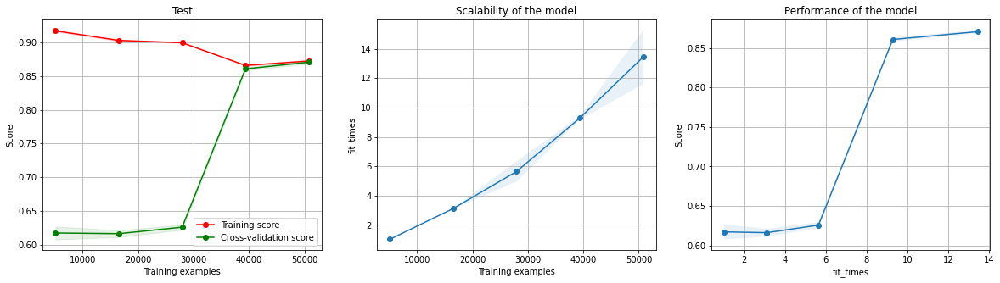
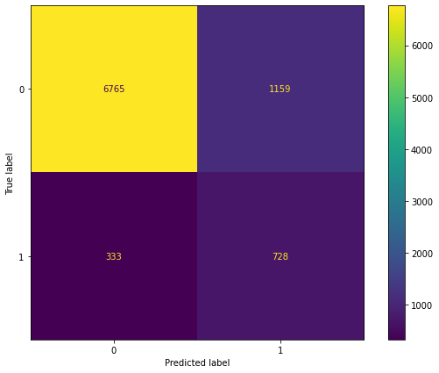
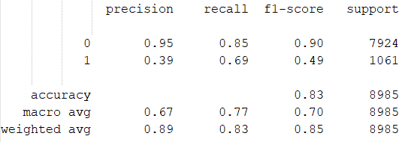
Gradient Boosting Classifier Model
Relatively good model with 0.83 accuracy and 0.49 F1 score and high recall, but with performance caveat
Model Learning Curve
Confusion Matrix
Classification Report

Slide 15
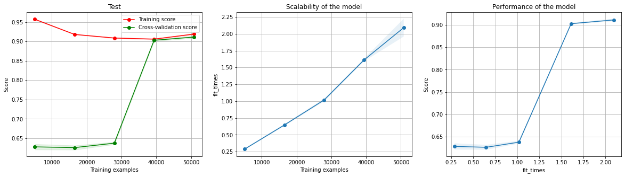
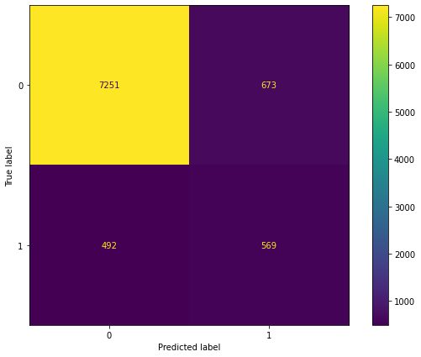
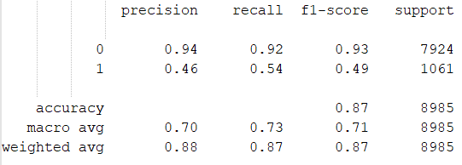
Light GBM Classifier Model
Modelling with LightGBM Classifier give us pretty good result with 0.87 accuracy and 0.49 F1 score, with better performance
Model Learning Curve
Confusion Matrix
Classification Report

Slide 16
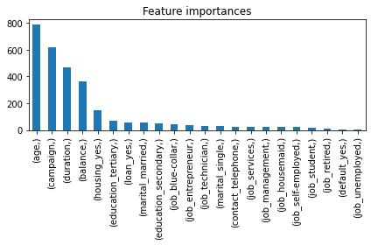

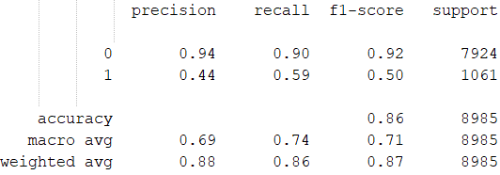
Tuned Light GBM Classifier Model
With the adjustment on its hyperparameter, this model give us the best result possible
Confusion Matrix
Classification Report
Notes:
F1 Score: 0.50
Accuracy: 0.86, 86 correct prediction out of 100
Recall: 0.59, out of 100 client who subscribed, 59 actually subscribed
Observation:
From our LightGBM Classifier Model feature importances, we know that the client age is the most important characterics to predict whether they will be persuaded by the telemarketing or not
Campaign frequency and the duration of the call are also important for the effectiveness of telemarketing campaign according to the model

Slide 17
Conclusions

Slide 18
Key Points
Business Recommendation
Roughly one-tenth of the clients that’s contacted by telemarketer actually subscribes to the bank’ term deposit (~11.7% conversion rate).
Client’s age is the most important factor to predict whether they will be persuaded by the telemarketing or not, with 30-50 years old being the most group willing to subscribe.
Campaign frequency and the duration of the call are also important for the effectiveness of telemarketing campaign.
If the investment is too big for the conversion rate, explore other direct marketing approach.
Target potential group that are more willing to buy the product.
Make clients engaged when cold calling (e.g.. small talks) so they are more willing to buy the product
Notes:
Actually pretty big conversion

Slide 19


Slide 20
Appendix

Slide 21
Dataset Python Code
https://www.kaggle.com/prakharrathi25/banking-dataset-marketing-targets
https://colab.research.google.com/drive/1Sq5P9to9Plmx1JjkmZf55uVD57dRDefG?usp=sharing

